Slide 1

Real-Time Embedded System for Signal Optimization in Battery Analysis
Project Lab Embedded Systems – Group 8
Taha Yassine Akermi, Fabian Schuh, Ibrahim El Khalil Chaida
Guided by: Dr. Ahmed Yahia Kallel
Technische Universität Chemnitz
Chair of Measurement and Sensor Technology
02.07.2025
Made with Genspark

Slide 2
Table of Contents
Background & Motivation
System Architecture
Hardware/Software Partitioning
Howland VCCS
Voltage-Measurement circuit and Current-Sensing circuit
Bandwidth
Linearity Verification
STM32 Integration
Raspberry Pi Visualization
Conclusion & Future Work

Slide 3
Background & Motivation
Battery impedance monitoring is crucial for:
.Electric vehicle performance and range optimization State-of-.health diagnostics in smart electronics
.Predictive maintenance and failure prevention
.Battery thermal management safety systems
Existing solutions have limitations:
.High cost, limited customizability
.Lack of real-time monitoring capabilities
.Complex integration with on-board systems
Our project addresses these gaps through:
.High precision (±1%) at lower cost
.Modular design adaptable to various battery chemistries Real-.time visualization and integrated data analysis
Notes:
To begin, let’s talk about why battery impedance monitoring is important.
It’s a critical function for a range of applications — from electric vehicle range optimization, to health diagnostics in smart electronics, and even in predictive maintenance and battery safety management.
Real-time monitoring helps prevent failures, improve performance, and manage thermal risks — especially in modern, high-density battery systems.
However, existing commercial solutions fall short. They are often expensive, not customizable, and don’t support real-time feedback. Also, their integration into embedded systems — like microcontrollers — is technically complex.
Our project is designed to bridge those gaps.
We aimed to deliver a cost-effective, high-precision system — achieving ±1% accuracy, with a modular analog design that supports different battery chemistries.
And unlike most commercial setups, we built real-time data visualization and analysis tools directly into the system — using embedded processing and a live dashboard.

Slide 4
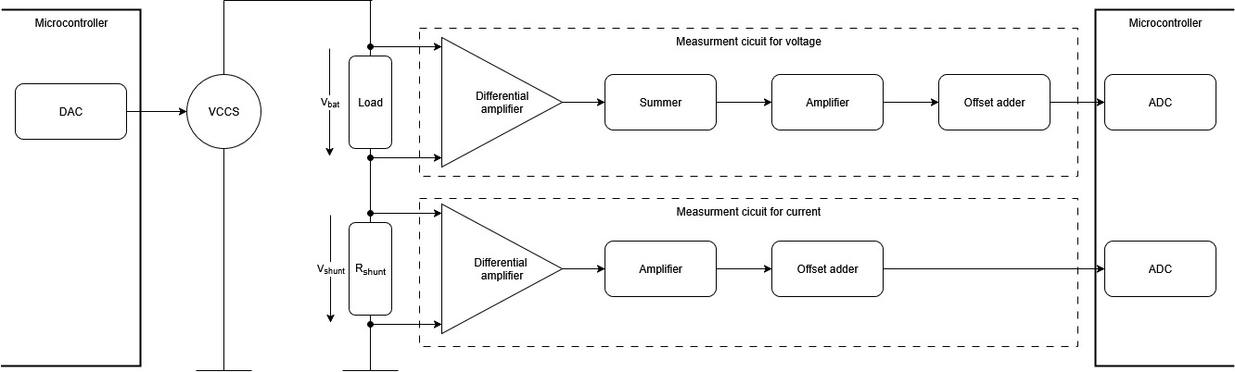
System Architecture
-The system starts with a DAC output generated by the STM32 microcontroller.
-fed into a Howland Voltage-Controlled Current Source (VCCS)
-current is injected into the battery under test, across a shunt resistor.
Resulting voltage and current signals are measured and sent through two analog signal circuit:
Voltage circuit and current circuit with differential amplifiers, offset correction, and gain stages
-The STM32 transmits data via UART to the Raspberry Pi.
System Block Diagram
Howland VCCS
Battery & Shunt
Diff Amps
STM32 ADCs
Figure 1 : Diagram
Notes:
The system starts with a DAC output generated by the STM32 microcontroller.
The signal is fed into a Howland Voltage-Controlled Current Source (VCCS) to produce a precise AC current.
This current is injected into the battery under test, across a shunt resistor.
Resulting voltage and current signals are measured and sent through two analog signal circuit :
Voltage circuit and current circuit with differential amplifiers, offset correction, and gain stages.
Signals are digitized using dual ADCs with DMA on the STM32 for real-time sampling.
The STM32 transmits data via UART to the Raspberry Pi.
A Flask-based dashboard on the Pi provides real-time visualization and data logging.
Architecture achieves high accuracy and low-latency — ideal for impedance analysis.

Slide 5
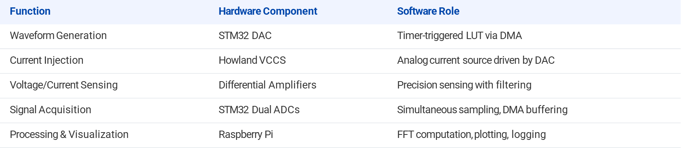
Hardware / Software Partitioning
Table 1 : hardware / software partitioning
Notes:
For waveform generation, we used the STM32 DAC, which outputs a sinusoidal signal using a timer-triggered lookup table via DMA — ensuring precise timing without CPU load.
• That DAC output is used to drive the Howland Current Source — the analog block responsible for injecting current into the battery. This is a purely hardware function, but it depends on the DAC-controlled voltage.
• Next, the battery response is sensed through differential amplifiers, handling both voltage and current paths. These analog stages provide high-precision signals, with built-in filtering and gain adjustment.
• The signals are then sampled using dual ADCs on the STM32, allowing simultaneous acquisition of voltage and current. We use DMA to transfer data efficiently with minimal delay.
• Finally, the data is sent via UART to the Raspberry Pi, which handles all processing and visualization tasks. It plots the data in real time and logs it for analysis, using a Flask-based dashboard and Chart.js frontend.

Slide 6
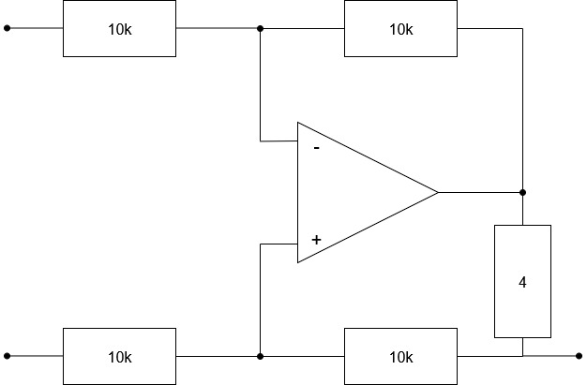
Howland VCCS
Converts DAC voltage output into precise AC current.
Classic Howland circuit topology with op-amp and resistor bridge.
Current remains independent of load, assuming matched resistors.
Ensures stable current injection into batteries of varying impedance.
Used precision resistor values and LTspice simulations for tuning.
Diagram 2 : Howland circuit
Notes:
This slide focuses on the Howland Voltage-Controlled Current Source, which plays a key role in our signal generation.
The goal here is to convert the DAC voltage output into a precise AC current that we can inject into the battery. That’s essential because impedance measurement requires controlled current excitation.
We implemented the classic Howland topology, which uses an op-amp and a resistor bridge. The advantage is that, when the resistors are precisely matched, the output current becomes independent of the load impedance.
This means we can drive different batteries with varying internal resistance and still get consistent current injection.
To ensure stability and symmetry, we used high-precision resistors and carefully matched the values using simulations in LTspice.

Slide 7
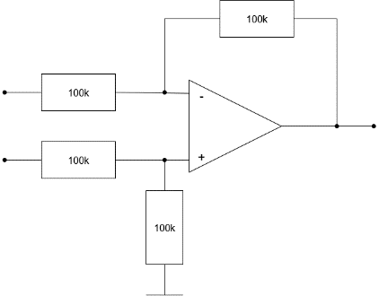
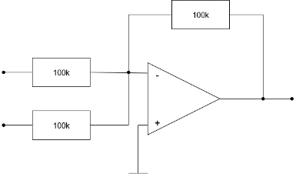
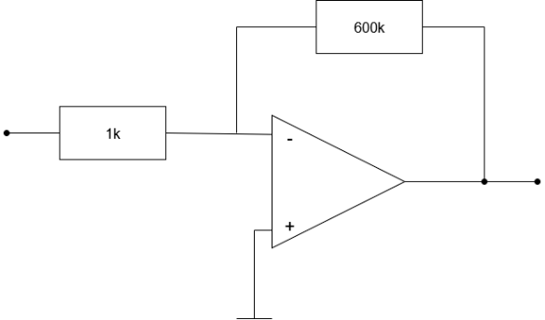
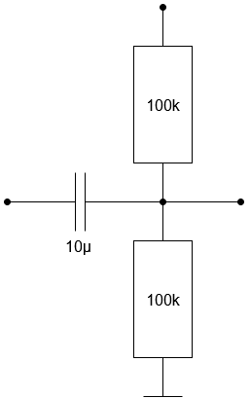
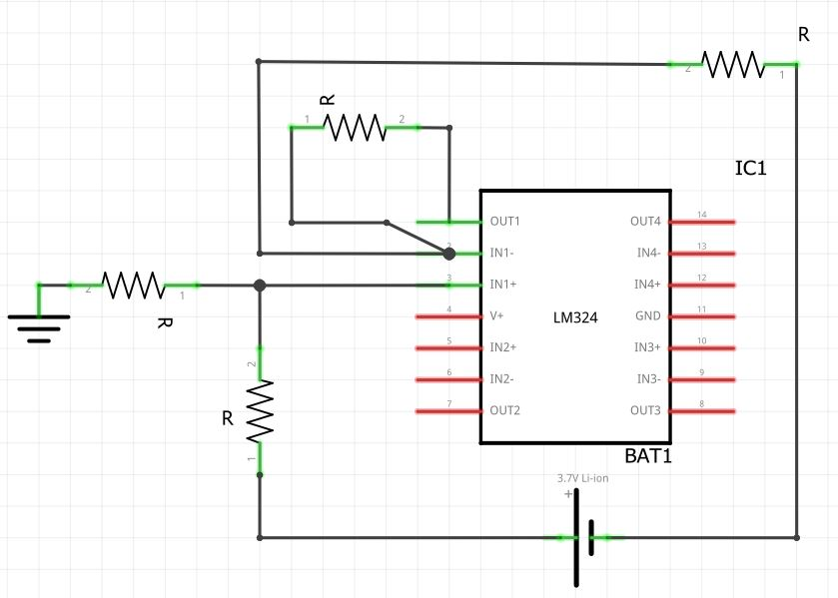
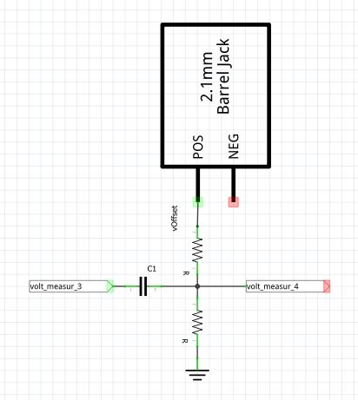
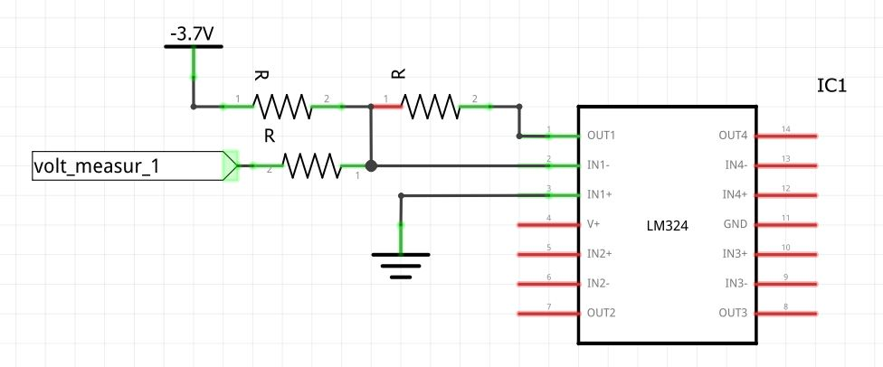
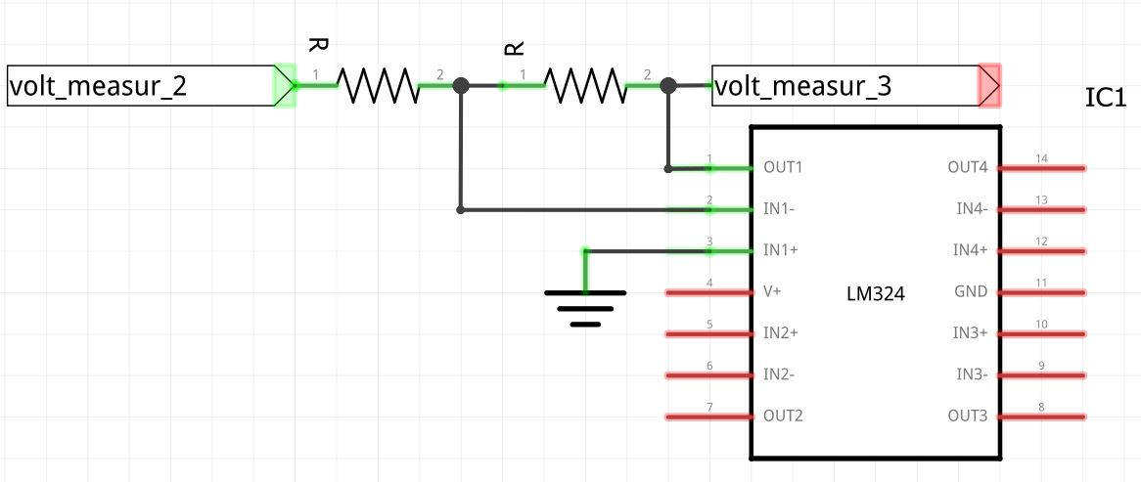
Voltage-Measurement circuit
Stage 1: Inverting differential amplifier (gain –1) with 100 kΩ resistors for battery voltage sensing
Stage 2: Differential summer (100 kΩ bridge) for offset removal
Stage 3: Inverting gain amplifier (gain –600) using R20 = 600 kΩ, R19 = 1 kΩ for signal magnification
Stage 4: AC coupling with 10 µF capacitor and DC offset injection (1.65V) for ADC input range
Stage 1
Stage 2
Stage 3
Stage 4
Figure 2: Volt stage 1
Figure 3: Volt stage 2
Figure 4: Volt stage 3
Figure 5: Volt stage 4

Slide 8
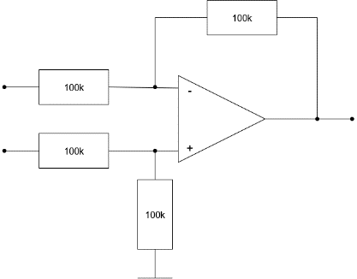
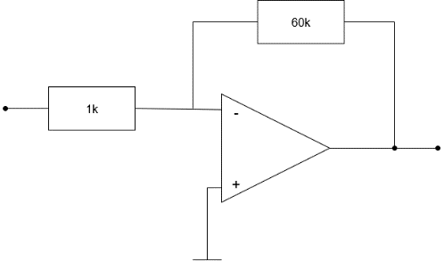
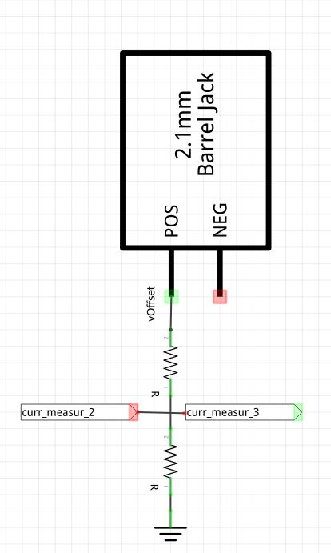
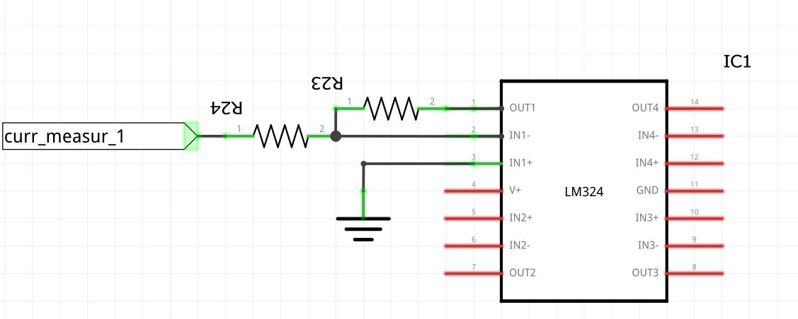
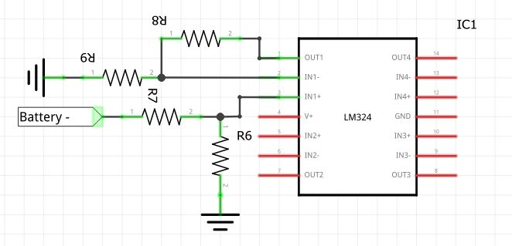
Current-Sensing circuit
Stage 1: Precision differential amplifier senses shunt voltage with 100 kΩ network, ensuring high CMRR and noise rejection
Stage 2: Inverting gain stage (gain – 60 )boosts signal using R24 = 60 kΩ and R23 = 1 kΩ to maximize ADC dynamic range
Stage 3:AC coupling with 10 µF capacitor and DC offset injection (1.65V) for ADC input range
Stage 1
Stage 2
Stage 3
Figure 6: Current stage 1
Figure 7: Current stage 2
Figure 8: Current stage 3

Slide 9
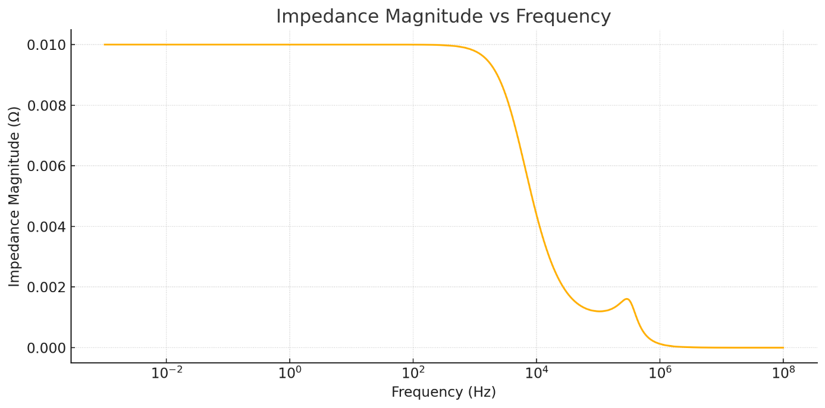
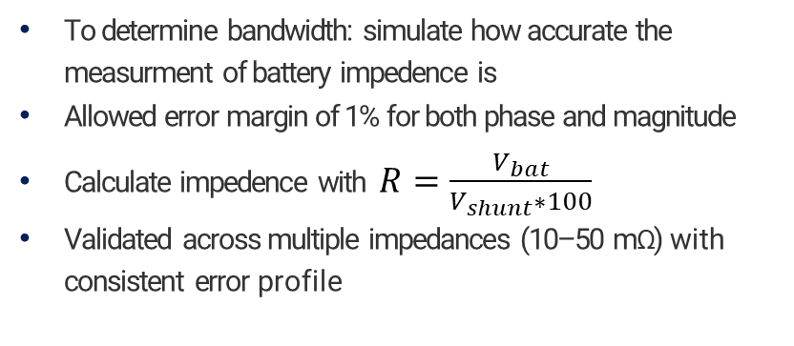
Bandwidth
To determine bandwidth: simulate how accurate the measurment of battery impedence is
Allowed error margin of 1% for both phase and magnitude
Calculate impedence with $R=\frac{V_{bat}}{V_{shunt}∗100}$
Validated across multiple impedances (10–50 mΩ) with consistent error profile
Figure 9: Impedance magnitude ac sweep with 10mΩ Impedance

Slide 10
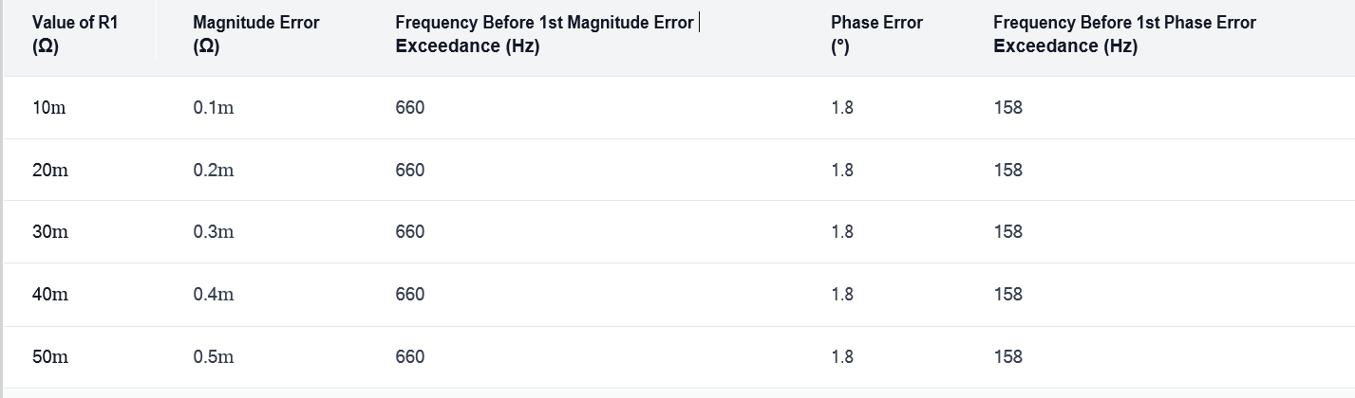
Bandwidth
Table 2: Bandwidth determination measurments
Cut-off frequency of 158 Hz determined by phase error exceeding ±1% threshold
Operating bandwidth is 158 Hz

Slide 11
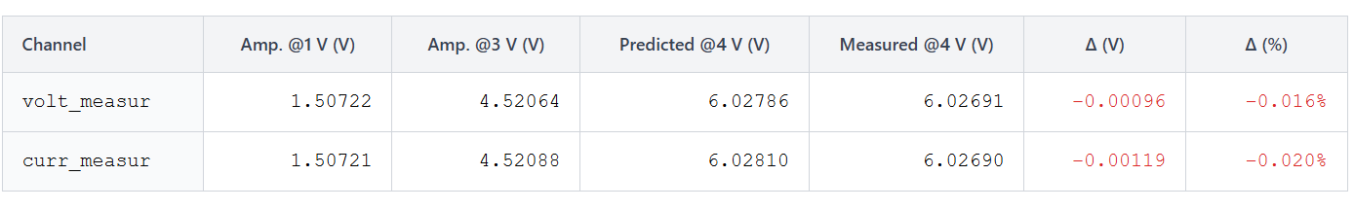




Linearity Verification
Homogeneity principle: Output scales proportionally with input amplitude (1V, 3V tests) with consistent gain of ~1.498 and minimal error (±0.1%)
Additivity principle: Combined response (1V + 3V) matches direct 4V input to within 0.02%, confirming superposition
Validation method: Multiple signal amplitudes tested to verify gain stability across operating range
Homogeneity accuracy:
99.9%
Additivity accuracy:
99.98%
Overall linearity:
≥ 99.7%
Table 3: Additivity verification

Slide 12
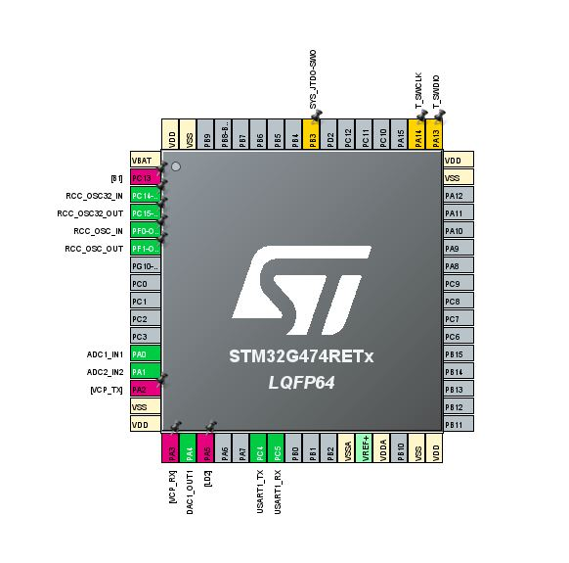
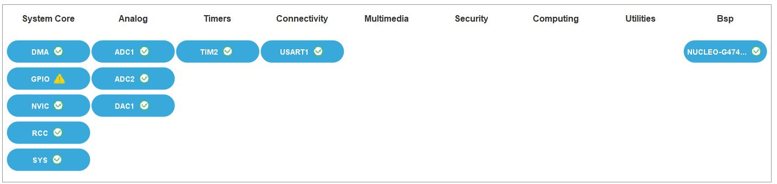
STM32 Integration
Dual synchronized ADCs sample voltage/current channels simultaneously, buffered via DMA to minimize CPU overhead and maintain real-time performance
DAC generates precise sine waveforms using timer-triggered DMA from look-up tables (LUTs), enabling programmable excitation frequencies and amplitudes
High-speed UART/SPI communication streams data packets to Raspberry Pi for visualization, with robust error handling and compact binary encoding
System configured using STM32CubeIDE with BSP, HAL and CMSIS libraries for hardware abstraction and platform portability
Figure 11 : stm 32 integration
Figure: 10 stm 32

Slide 13
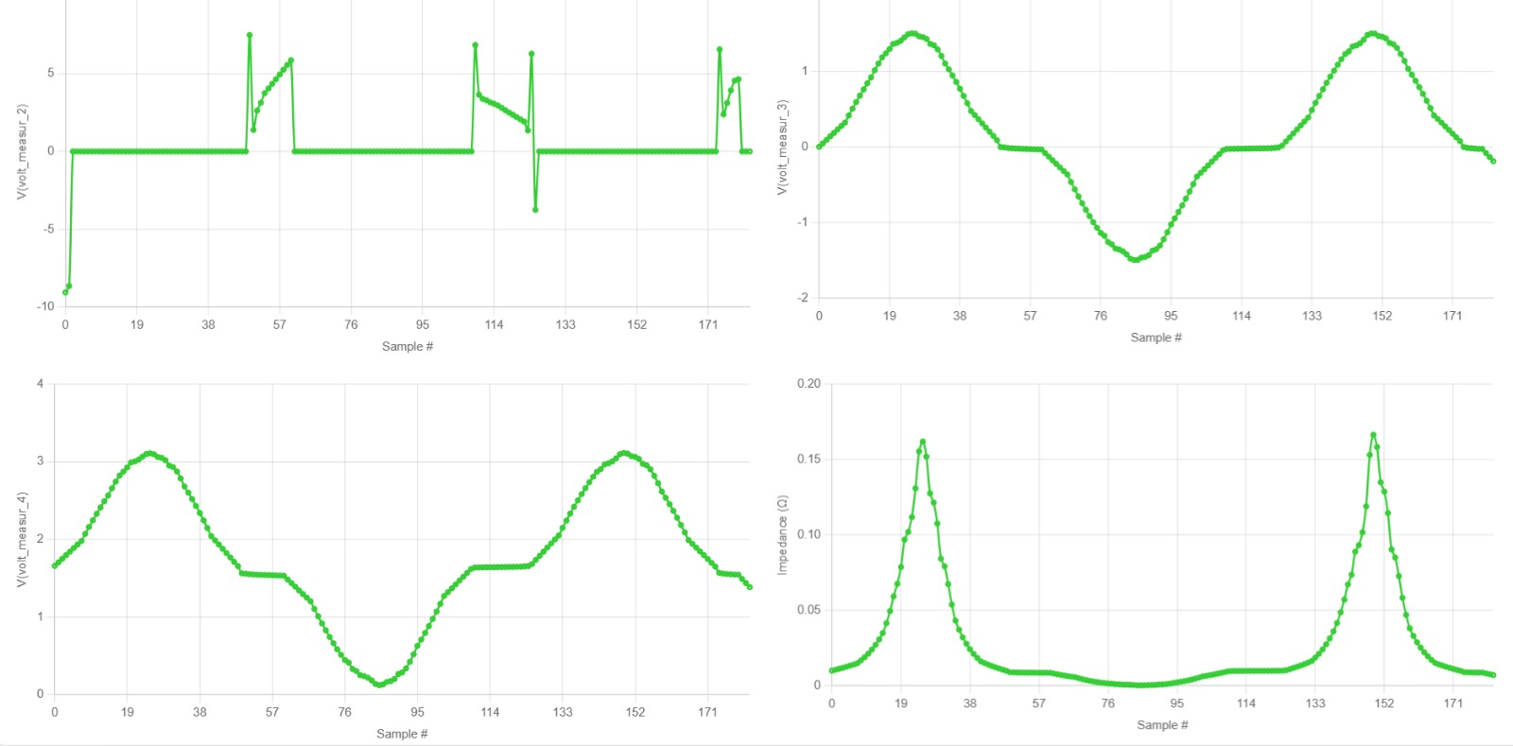

Raspberry Pi Visualization
Python Flask back-end parses incoming data, computes impedance (Z = Vbat/Vcurr × 0.01)
📊
Real-time Dashboard Visualization
Real-time browser dashboard (Chart.js) animates 7 signals + impedance plot at 100 ms intervals
User interface built in HTML/CSS/JS; supports data logging and playback
8-panel Chart.js grid showing signals and impedance plots
Figure 12 : Rasberry pi visualisation

Slide 14
Conclusion & Future Work
Developed/simulated complete modular embedded system; verified VCCS, STM32, and software chain in hardware
Achieved high precision (±1%) and robust bandwidth in shunt simulations
Next steps: Deploy full analog signal chain in hardware, validate under noise/real battery conditions, benchmark against industry analyzers
In the future, the measuring circuits should be activated and commissioned. Subsequent measurements can then be performed to confirm or refute the simulation results. For example, real-world electrical noise may negatively impact system performance. If any performance or accuracy degradation is observed between simulation and actual hardware, these issues will need to be investigated further and appropriate solutions developed.

Slide 15
References
Kanoun, O., Kallel, A.Y. (2024). High-performance efficient embedded systems for impedance spectroscopy: Challenges and potentials. Researchgate. Retrieved from: https://www.researchgate.net/publication/380232368_High- performance_efficient_embedded_systems_for_impedance_spectroscopy_Challenges_and_potentials
Kallel, A.Y. (2024). Design of Optimized Broadband Excitation Signals for Consistent Impedance Spectroscopy Measurements. Researchgate.
Texas Instruments. An engineer's guide to current sensing (Rev. B). Retrieved from: https://www.ti.com/lit/eb/slyy154b/slyy154b.pdf
Analog Devices (2025). Data Sheet ADA4522-1/ADA4522-2/ADA4522-4. Retrieved from: https://www.analog.com/media/en/technical- documentation/data-sheets/ada4522-1_4522-2_4522-4.pdf
ST Microelectronics. STM32 Nucleo-64 development board with STM32G474RE MCU. Retrieved from: https://www.st.com/en/evaluation- tools/nucleo-g474re.html

